Slide 1

Concern about Cyber Attack
Safuan,M.Kom
ALLPPT.com _ Free PowerPoint Templates, Diagrams and Charts

Slide 2

Cyber Attack
In computer and computer networks, an attack is any attempt to expose, alter, disable, destroy, steal or gain unauthorized access to or make unauthorized use of an asset.
A cyber attack is any type of offensive maneuver that targets computer information systems, infrastructures, computer networks or personal computer devices.
An attacker is a person or process that attempts to access data, functions or other restricted areas of the system without authorization, potentially with malicious intent.
Source : Wikipedia.org

Slide 3
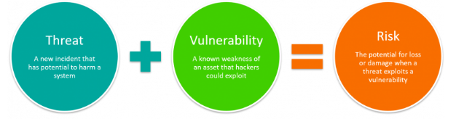
Risk on Cyber
Source : bmc.com

Slide 4
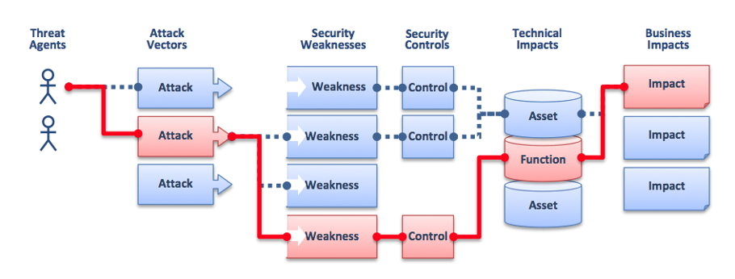
OWASP : Relationship between Threat Agent and Business Impact
Source : www.ictea.com

Slide 5
Threat
A threat refers to a new or newly discovered incident that has the potential to harm a system or your company overall.
Natural threats, such as floods, hurricanes, or tornadoes
Unintentional threats, like an employee mistakenly accessing the wrong information
Intentional threats, such as spyware, malware, adware companies, or the actions of a disgruntled employee

Slide 6
Vulnerability
A weakness of an asset or group of assets that can be exploited by one or more threats where an asset is anything that can has value to the organization, its business operations and their continuity, including information resources that support the organization's mission
Source : ISO 27005

Slide 7
Vulnerability
In computer security, a weakness in automated systems security procedures, administrative controls, Internet controls, etc., that could be exploited by a threat to gain unauthorized access to information or to disrupt critical processing.
In computer security, a weakness in the physical layout, organization, procedures, personnel, management, administration, hardware or software that may be exploited to cause harm to the ADP system or activity.
In computer security, any weakness or flaw existing in a system. The attack or harmful event, or the opportunity available to a threat agent to mount that attack.
Source : Data and Computer Security: Dictionary of standards concepts and terms, authors Dennis Longley and Michael Shain, Stockton Press

Slide 8
Classification of Vulnerability
Hardware
Personel
Susceptibility to humidity, dust, soiling and unprotected storage
Inadequate recruiting process and security awarenes
Software
Site
Insufficient testing, lack of audit trail
Area subject to flood, unreliable power source
Network
Organizational
Unprotected communication lines
Insecure network architecture
Lack of regular audits
Lack of continuity plans
Lack of security

Slide 9
Causes of Vulnerability
Complexity
Password management flaws
01
Large, complex systems increase the probability of flaws and unintended access points
04
The computer user uses weak passwords that could be discovered by brute force. The computer user stores the password on the computer where a program can access it. Users re-use passwords between many programs and websites.
Familiarity
02
Using common, well-known code, software, operating systems, and/or hardware increases the probability an attacker has or can find the knowledge and tools to exploit the flaw
Fundamental operating system design flaws
05
The operating system designer chooses to enforce suboptimal policies on user/program management. For example operating systems with policies such as default permit grant every program and every user full access to the entire computer. This operating system flaw allows viruses and malware to execute commands on behalf of the administrator.
Connectivity
03
More physical connections, privileges, ports, protocols, and services and time each of those are accessible increase vulnerability

Slide 10
Causes of Vulnerability
Internet Website Browsing
Unchecked user input
06
Some internet websites may contain harmful Spyware or Adware that can be installed automatically on the computer systems. After visiting those websites, the computer systems become infected and personal information will be collected and passed on to third party individuals.
08
The program assumes that all user input is safe. Programs that do not check user input can allow unintended direct execution of commands or SQL statements (known as Buffer overflows, SQL injection or other non-validated inputs)..
Software bugs
Not learning from past mistakes
07
09
For example most vulnerabilities discovered in IPv4 protocol software were discovered in the new IPv6 implementations
The programmer leaves an exploitable bug in a software program. The software bug may allow an attacker to misuse an application.

Slide 11
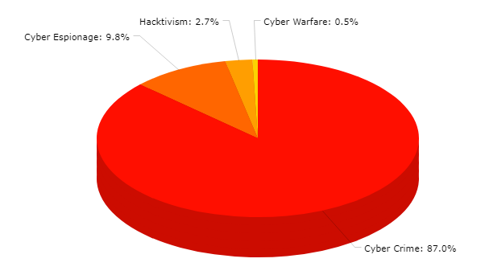
Motivations Behind Attacks
(May 2020)
Source : hackmageddon.com

Slide 12
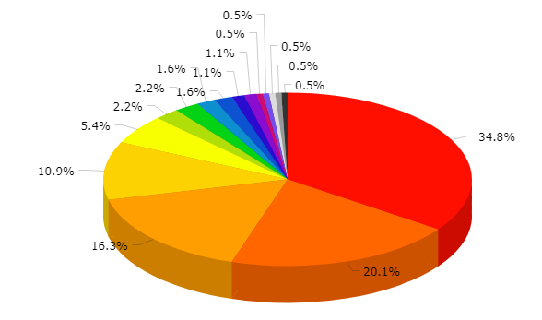
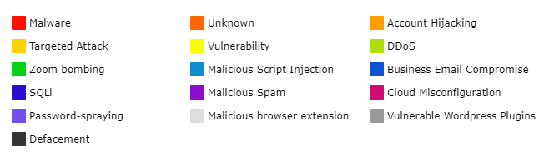
Attack Techniques
(May 2020)
Vulnerability
Malware
Targeted Attack
Account Hijacking
Source : hackmageddon.com
Unknown

Slide 13
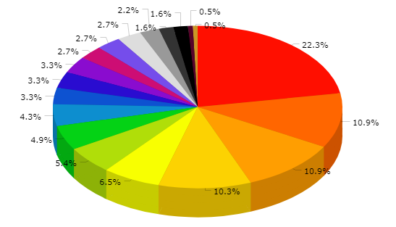
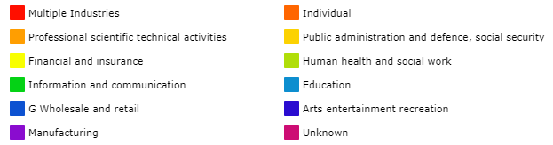
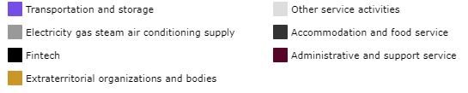
Targets
(May 2020)
Industries
Individual
Professional, Scientific, Technical Activities
Source : hackmageddon.com

Slide 14
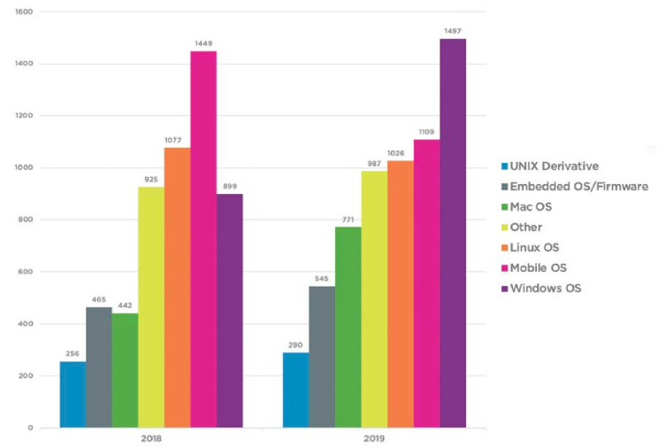
Most vulnerable operating systems (2018-2019 )
Source : skyboxsecurity.com

Slide 15
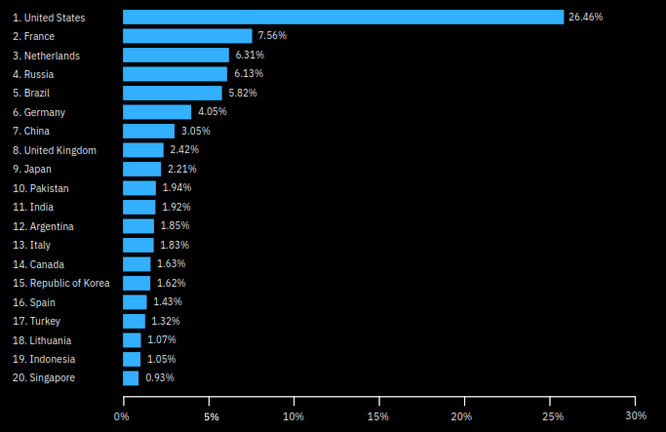
Top 20 spam C2 hosting countries
Top 20 countries according to their share of spam command and control (C2) servers globally in 2019
Source : IBX-XForce

Slide 16
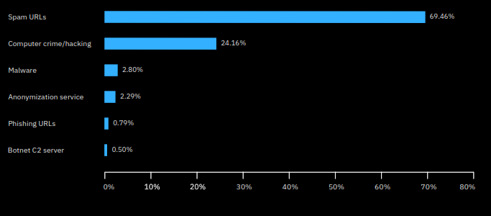
Top malicious domain threat types
Breakdown of top malicious domain threat types, as a percentage of the six types shown, in 2019
(Source: IBM X-Force and Quad9)

Slide 17
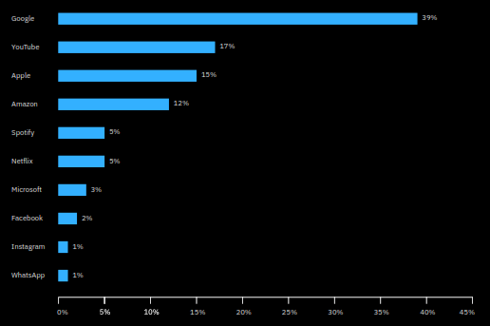
Top 10 spoofed brands
Breakdown of the top 10 brands spoofed in spam in 2019
(Source: IBM X-Force)

Slide 18
Protect Against Cyberattacks
Do not open email attachments from unknown senders
Update your software and operating system
Do not click on links in emails from unknown senders or unfamiliar websites
Use anti-virus software
Avoid using unsecure WiFi networks in public places
Use strong passwords

Slide 19
Research on Cyber Attack
XSS (Cross Side Scripting)
Phising
SPAM
Journal of Inteligent System
Penanganan Fitur Kontinyu dengan Feature Discretization Berbasis Expectation Maximization Clustering untuk Klasifikasi Spam Email Menggunakan Algoritma ID3

Slide 20
THANK YOU

